Slide 1
Resume screening and job recommendation system
By Esther Waweru

Slide 2
Outline
Background
Dataset overview
Model architecture
Results
Further enhancements

Slide 3

Background
In today’s competitive job market, recruiters face the critical task of manually screening thousands of resumes for limited job openings.
This process is time-consuming, prone to bias, and often fails to identify the most suitable candidates.
This project proposes a dual-purpose platform that will support both employers and job seekers with an automated resume screening and job recommendation system that leverages Natural Language Processing (NLP) techniques to automate and enhance the recruitment process.
Use of deep learning-based language models and similarity search methods to match resumes with job descriptions and vice versa.

Slide 4
Dataset Overview
Sourced the resume dataset of 2,484 entries from Kaggle https://www.kaggle.com/datasets/snehaanbhawal/resume-dataset
The resume data comprises of 24 categories of resume holders i.e. HR, designer, IT, teacher, advocate, business-development, healthcare, fitness, agriculture, BPO, Sales, Consultant, Digital media, automobile, chef, finance, apparel, engineering, accountant, construction, public-relations, banking, arts and aviation.

Slide 5
The job listings dataset of 500 entries was sourced from Adzuna jobs API with the focus being in the UK.
It contains 25 job categories as listed: Accounting & finance, Admin, Consultancy, Creative & Design , Customer Service, domestic help and cleaning , Engineering, Graduate, Healthcare & Nursing, Hospitality & Catering, HR & Recruitment, IT, Legal, Logistics & Warehouse, Maintenance, Manufacturing, Part time, other/general, PR Advertising &Marketing, Property, retail, Sales, Social work, Teaching and Trade & Construction

Slide 6
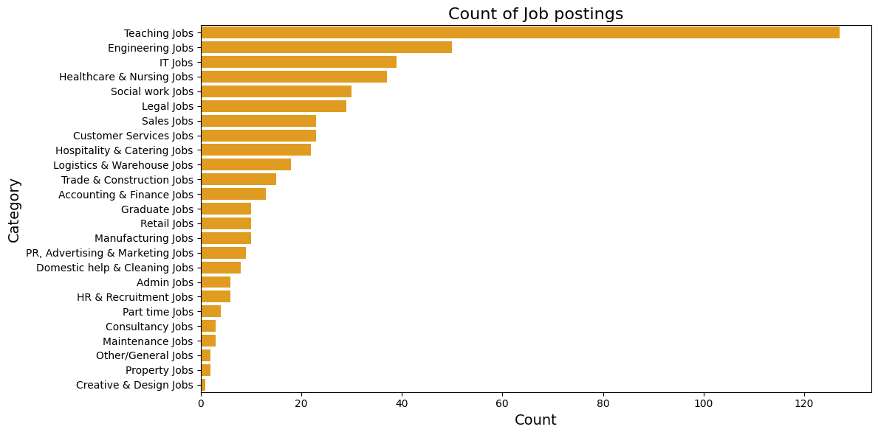
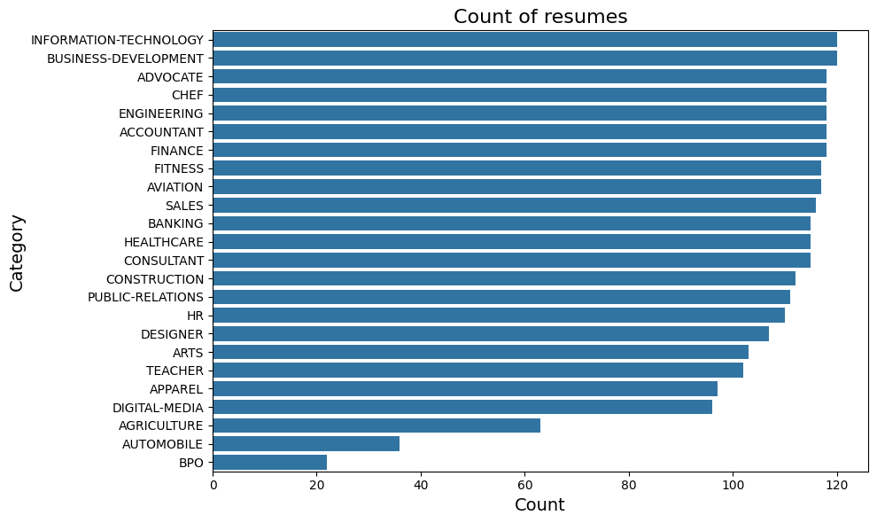

Slide 7

Model Architecture

Slide 8
Sentence Bidirectional Encoder Representations from Transformers (SBERT)
SBERT has a strong performance in semantic similarity as it gets to understand the context of a sentence by looking at how words relates to each other and not just in isolation as BERT does.
sBERT: Optimized for sentence-level embeddings. Uses a Siamese architecture to compute similarity efficiently, enabling fast comparisons in retrieval systems like FAISS (Facebook AI Similarity Search).
The model was built on the all-miniLM-L6-V2 which is light and fast and has a max token length of 512 and output dimension of 384.
SBERT is based on the transformer model which is a neural network architecture for NLP tasks and uses an encoder and decoder.
It is built on BERT which employs an encoder only architecture suggesting a primary emphasis on understanding input sequences.
BERT: Generates context-aware embeddings at the word(token) level whereas, SBERT is fine-tuned for sentence-level embeddings.

Slide 9
VoyageAI
Voyage embeddings are produced by Voyage AI models.
They are pre-trained transformer - based language models that produce sentence-level embeddings, just like SBERT.
Used Voyage-2 model for its high accuracy and speed. It has an output dimension of 1024 and max token length of 8192 making it excellent for long documents as is with the resume and job datasets used in the project.
Compare embeddings using cosine similarity.

Slide 10
Facebook AI Similarity Search (FAISS)
FAISS is a library used for similarity search and clustering of dense vectors.
It works by building an index of the documents to be searched/retrieved (the documents are represented as vectors) and makes nearest neighbour searches for the most similar vectors using the distance metrics cosine similarity, using an algorithm like K-means clustering. This helps organize and retrieve vectors fast and efficiently.
Pairing of Voyage/SBERT + FAISS enables fast and scalable similarity search across large collections of resume and job embeddings.

Slide 11
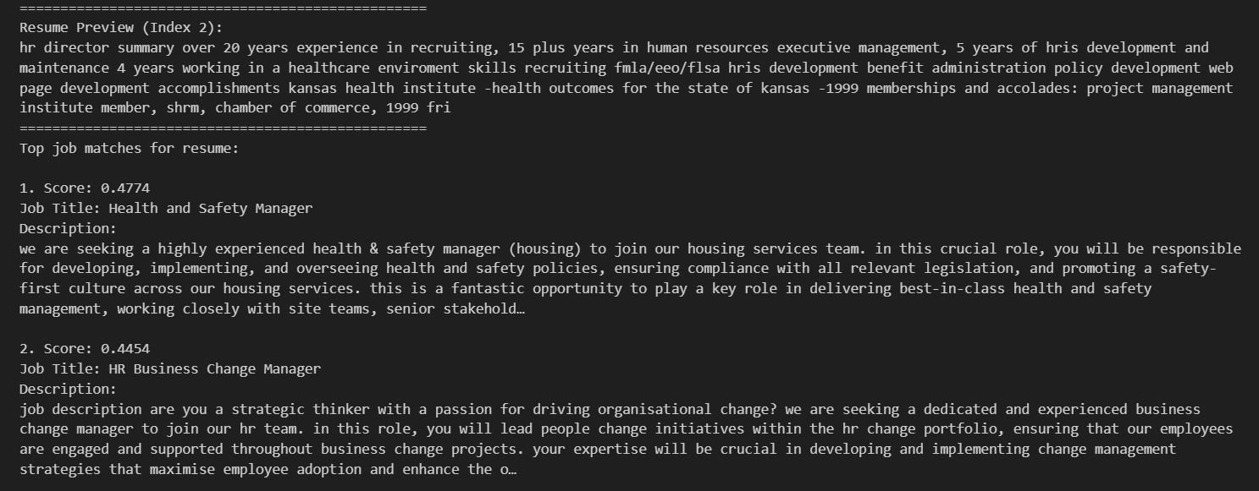
Results – SBERT (Resume – jobs)

Slide 12
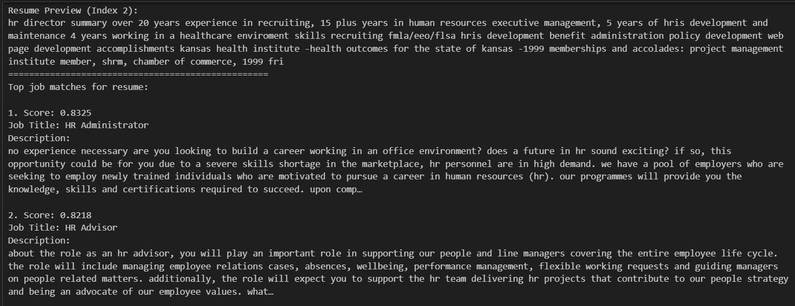
Results – Voyage Embeddings (resume-job)

Slide 13
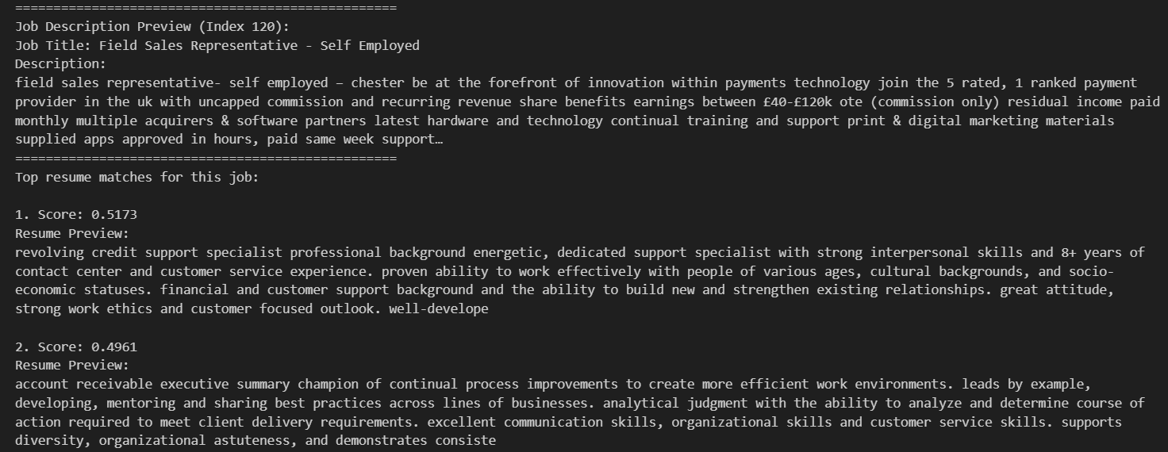
Results – SBERT (Job – resume)

Slide 14
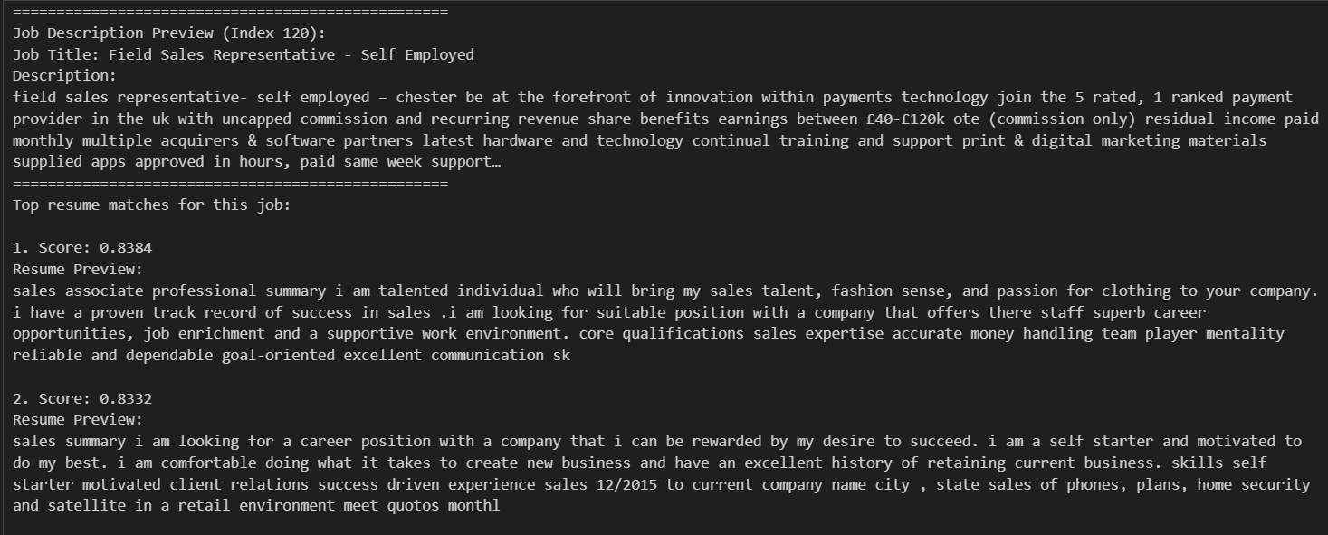
Results – Voyage Embedding (Job-resume)

Slide 15
Evaluation
Evaluated the SBERT and Voyage AI embeddings using the silhouette score and specified the metrics on cosine similarity.
Silhouette score is a metric used to evaluate the quality of clustering in unsupervised ML as is in this case. It measures how well a data point fits within its assigned cluster compared to other clusters.
Values range from -1 to 1. A high score of close to 1 or 1 indicates data points are well clustered whereas a score near 0 suggests overlapping clusters and negative scores indicate potential misclassification.
Silhouette Scores:
SBERT Resumes: 0.1184 VoyageAI Resumes: 0.1070
SBERT Jobs: 0.0898 VoyageAI Jobs: 0.1024
The scores are relatively low but Voyage AI appears to be performing slightly better than SBERT. Voyage AI might be having the upper hand due to its ability to handle long text inputs as well the high dimension.

Slide 16
Further Enhancements
Create a functionality for seeking certain specific criteria or special conditions for a job requirement.
Have a recommendation system for job seekers on what to do to increase their qualification or match up to a certain job.

Slide 17
Thank you

